Slide 1

Debricking Embedded/IOT Devices
Brad Welch
Red Team 8/30/2018
Vap0r at quelabs.com @Vap0rz

Slide 2
TOC
Define IOT/Embedded
Great attack vector
Tools required
Serial Data
No standards here
Determining pins or contact points
Baud, parity and flow control
The debrick <Insert attacks here>
Questions

Slide 3
IOT/Embedded devices
Internet Of Things
Nest Thermostat
Home security cameras
Alexa type devices
Philips Hue
Refrigerators
Embedded devices
Wireless routers
Fiber or Cable modems
Network Attached Storage devices
Home Theater
Televisions

Slide 4
Recovery Vector
Many devices come from the factory with test points on the PCB (printed circuit board) to allow troubleshooting and flashing or managing the micro OS. These test points allow access to low level boot processes that typically have no security controls and do not require authentication.
Not covering JTAG right now- Focus is on serial communications
Demo on a very old Netgear WNR854T wireless router - easiest to recover with this method

Slide 5
Tools
Something to expose the PCB (screwdrivers, torx, hammer, torch)
FTDI to USB converter- Converts Serial or TTL logic to USB or Bus Pirate
Windows or Linux PC with USB port to interact with FTDI
Multimeter with continuity check or resistance
In this example, TFTP server with new firmware set for pxe boot

Slide 6
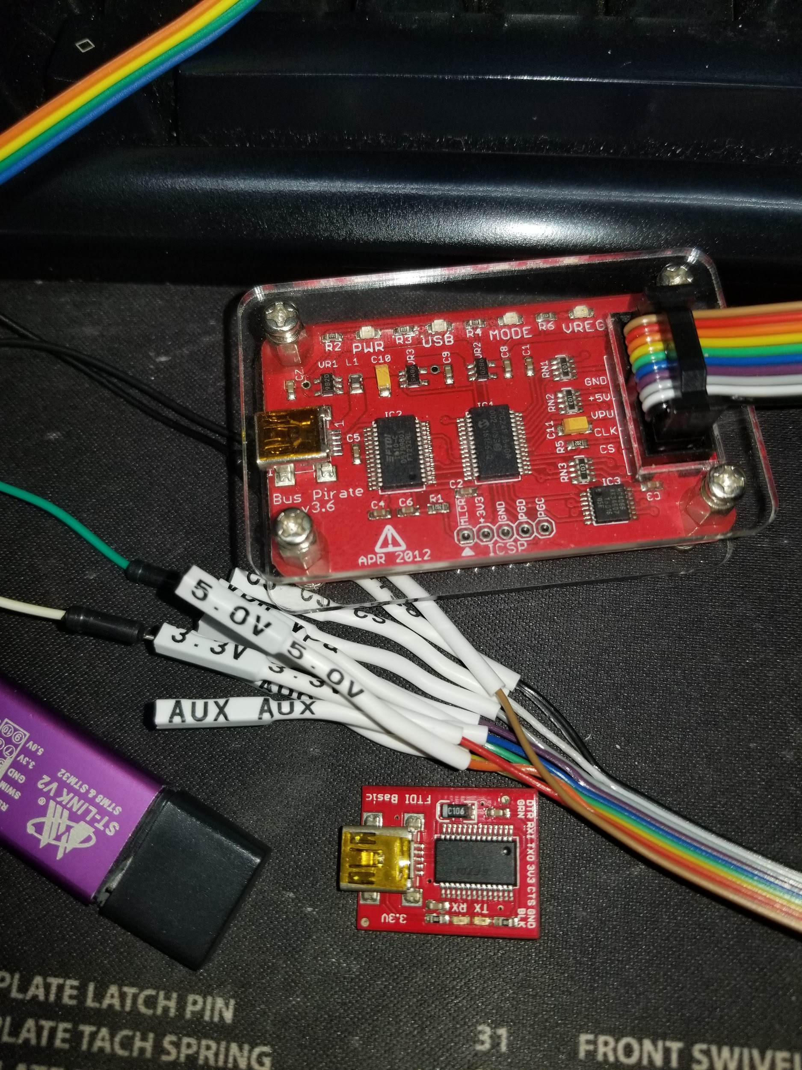
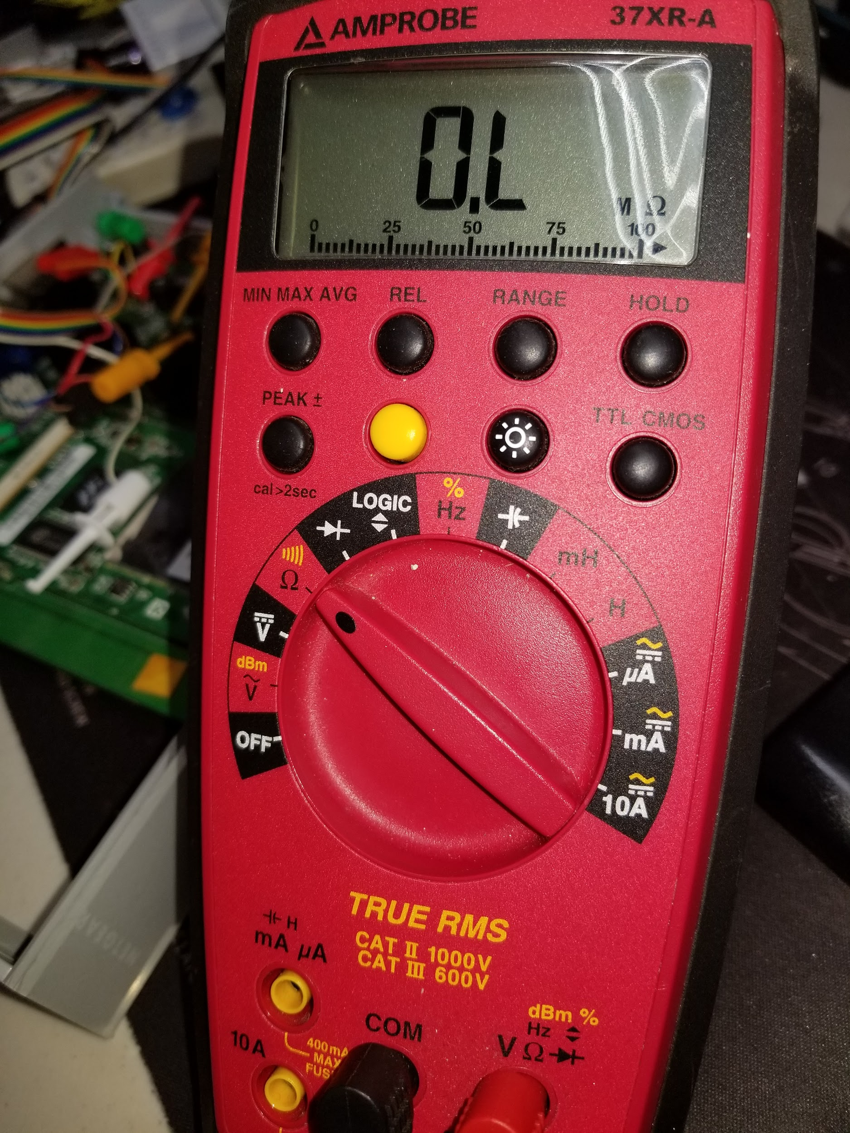
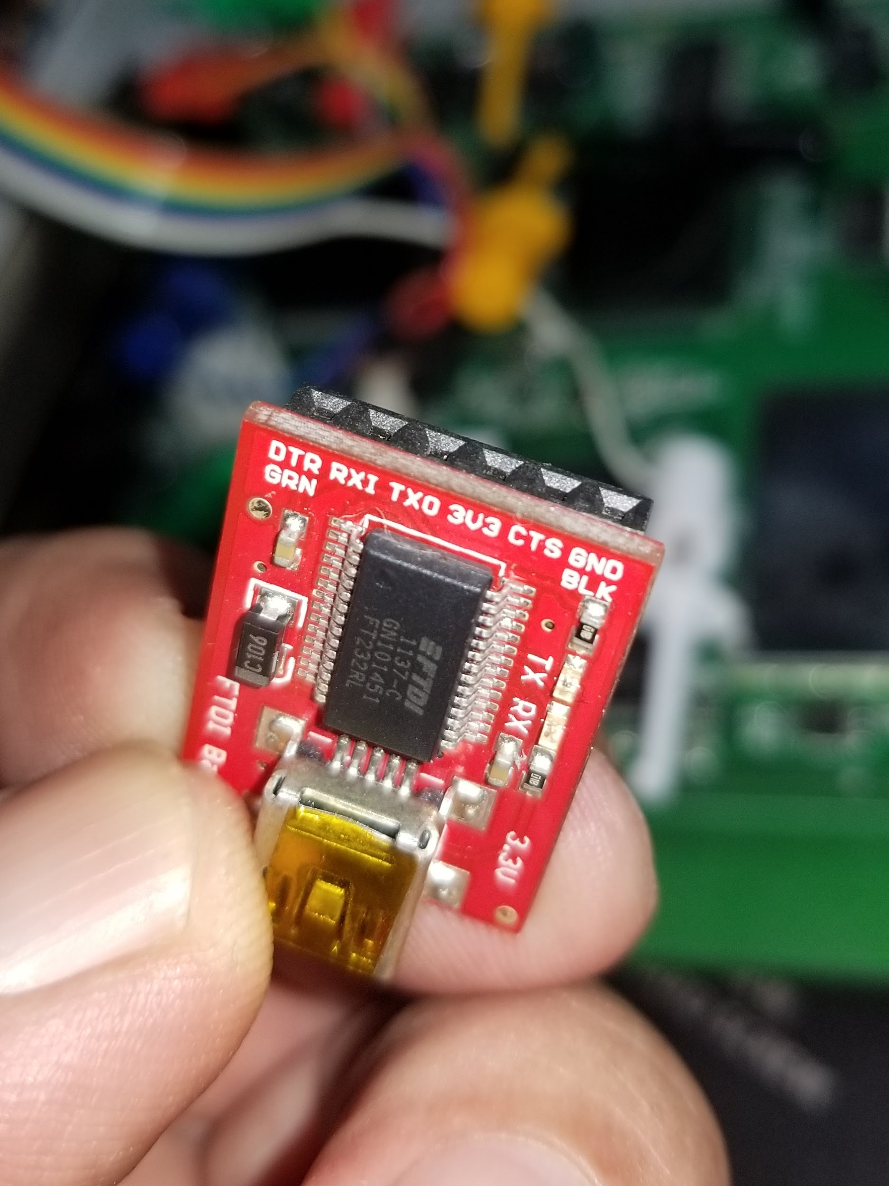
Tools

Slide 7
FTDI
“FTDI is used for converting RS-232 or TTL serial transmissions to USB signals, in order to allow support for legacy devices with modern computers” (FTDI wiki)
This converts voltage levels (Transistor Type Logic) so USB can understand the different signal voltages
RS-232 ranges from -25 Vc to +25 Vc where as TTL is typically 0 - 3.3 Vcc
Odd note that a binary 1 in RS-232 is -30 Vc where a binary 1 in TTL is 3.3 Vcc
RS-232 is sometimes referred to as Bi-polar as both positive and negative voltages are used for signaling

Slide 8
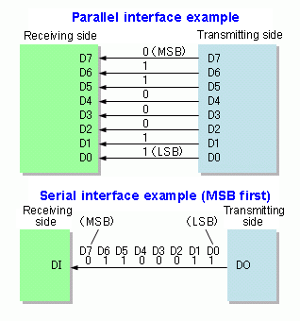
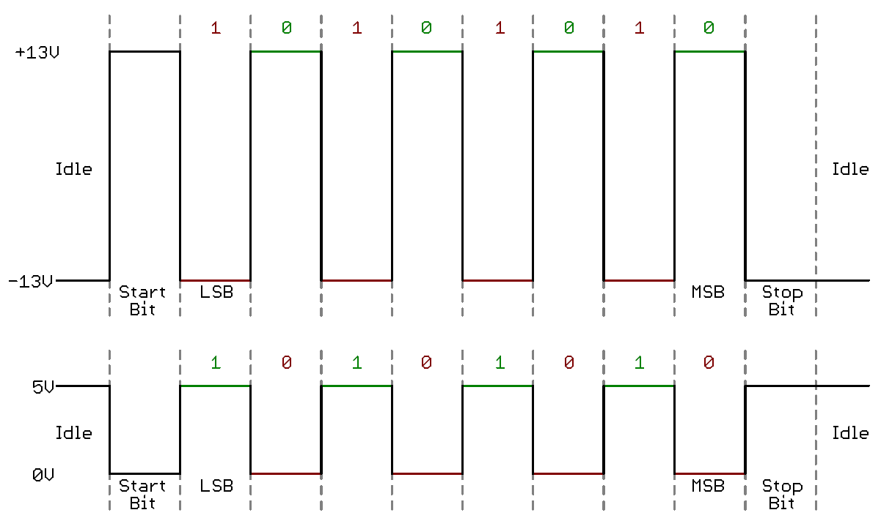
Serial Data Vs Parallel

Slide 9
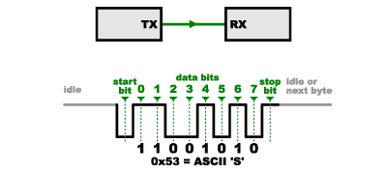
Serial Data
Serial data is an asynchronous communication protocol for sending data one bit at a time on a single bus where as Parallel can send data in large groups or chunks on several different lines.
Minimum requirements to receive and transmit on a serial port:
Tx Rx and Ground for reference. Because data is asynchronous there is no need for clock or RTS signals.There may be times when power is needed during dirty or noisey connections.

Slide 10
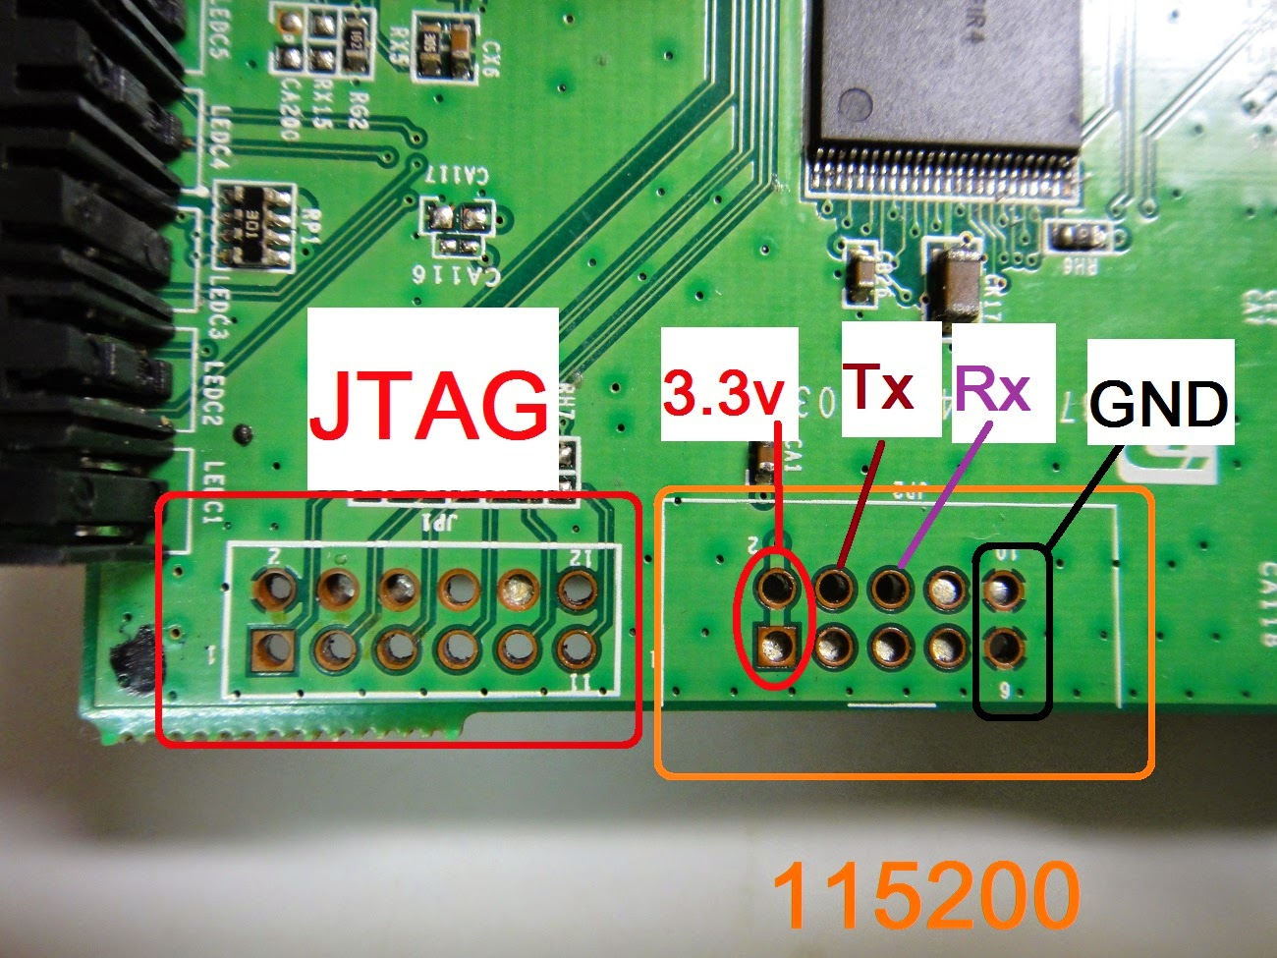
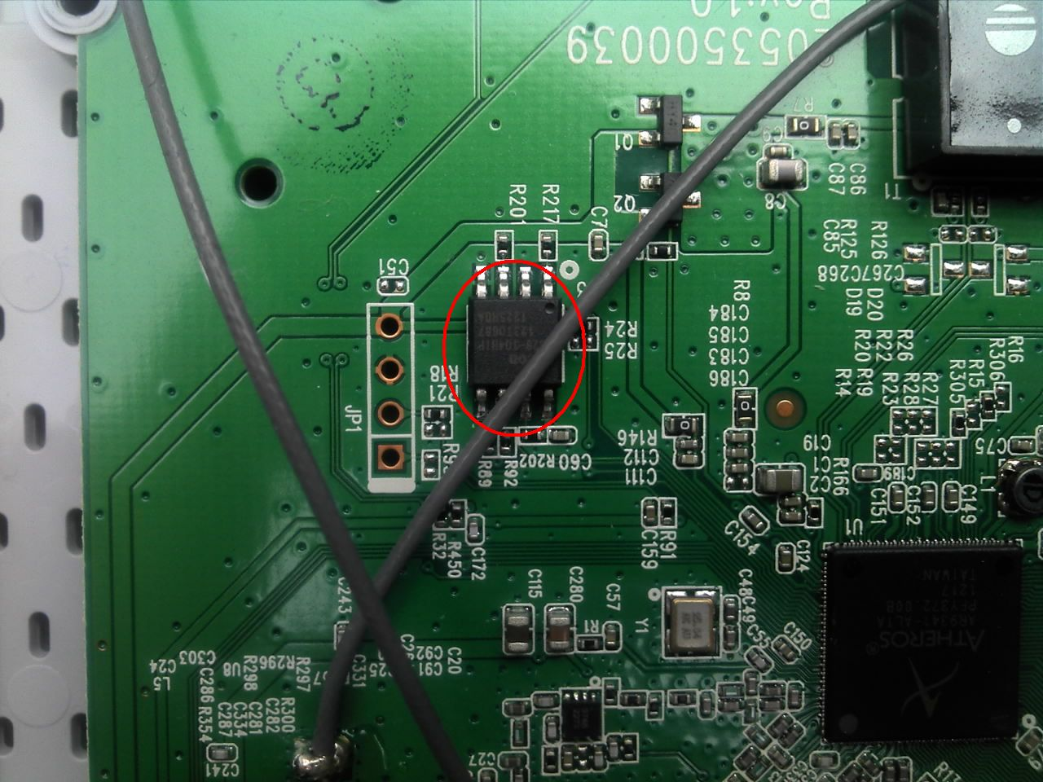
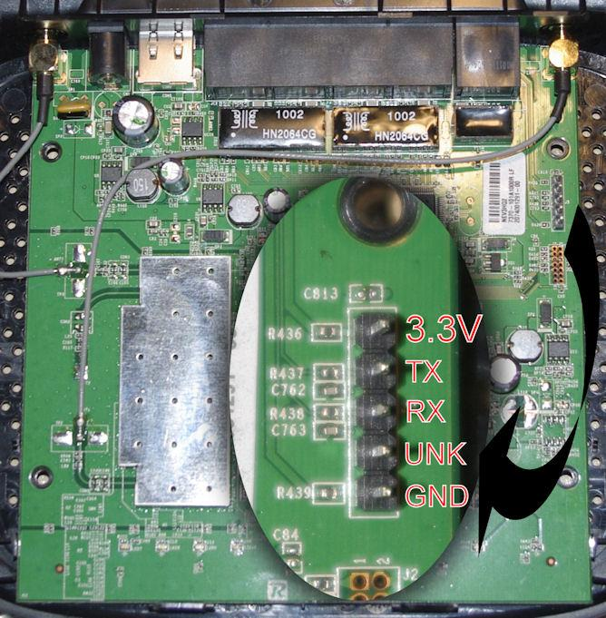
No standards for TP’s
Almost every modern PCB with a microcontroller will have test points for serial and or JTAG.
Not always easy to determine which pins are Vcc Rx Tx and Ground
Typically you’ll want to look for a single row of 4-6 pins (a 10 pin 5x5 is usually for JTAG) Note square pad

Slide 11
Identifying correct TP’s
First I look for the ground TP. Using a multimeter set on continuity or ohms, device is powered off, place one lead on a good known ground. Usually any metal shielding is a good ground, the other probe will touch each TP pin, looking for continuity. Continuity will indicate this is your ground pin.
Switching the multimeter to VDC, power on the device and keeping the ground probe still grounded, check the other pins for 3.3-3.5 Vdc. This will be the Vcc or power OR the TX pin. Remember that on TX TP the voltage is high until it sends data. Vcc will be steady 3.3 Vcc and the TX will bounce around especially if data is being transmitted.

Slide 12
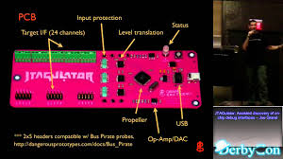
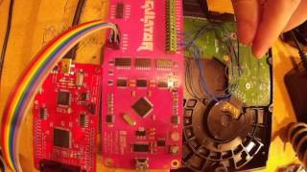
Easier way - Jtagulator
Jatagulator is a hardware device that will check every pin for you and let you know what each pin is used for. Roughly $150 from Joe Grand, works well for JTAG too.

Slide 13
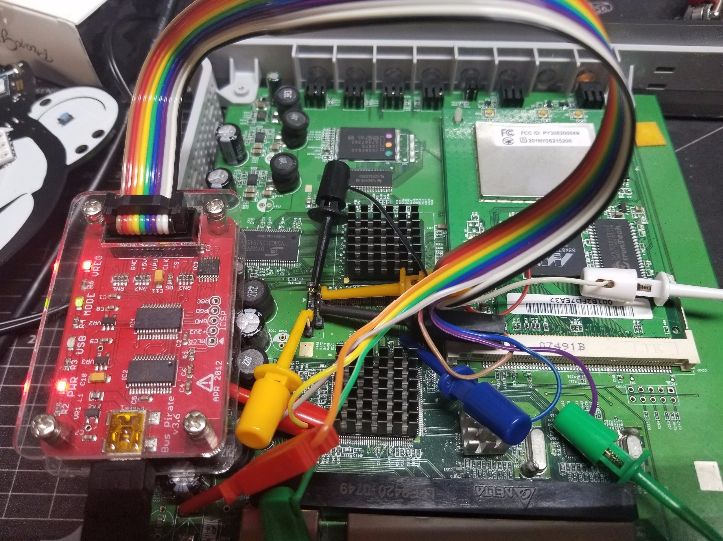
What it looks like

Slide 14

Connecting FTDI to the device
There are several FTDI or UART USB devices, all with different pinouts but they are usually marked for you. I normally use BusPirate as it supports several different types of connections (SSPI, 1 wire, UART, JTAG) and has the ability to change parameters like normal signal start or open drain.
On Windows, check what COM port your FTDI or BP device is on
In Linux you can check the port with dmesg typically /dev/ttyAMC0 or /dev/ttyUSB0

Slide 15
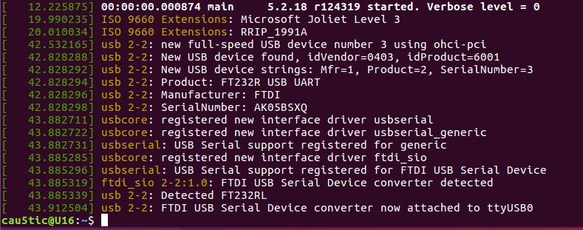
Connecting to USB (FTDI)

Slide 16
Connecting to USB (FTDI)
Open a terminal using whatever- putty, minicom or screen
Set terminal specifics such as Port, Baud, parity, stop and flow control
115200 or 9600 Baud is fairly standard along with 8N1.
8 Data Bits, No Parity and 1 stop bit.
Flow control is typically not used
Once connected hit return/enter and you should have a response
Many times you will want to establish a serial connection and reboot the target device

Slide 17
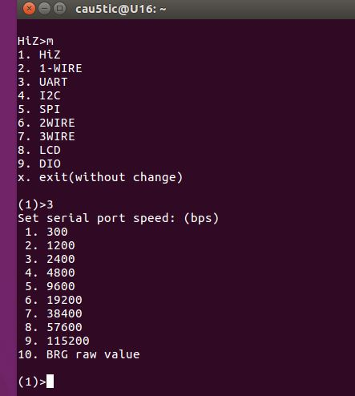
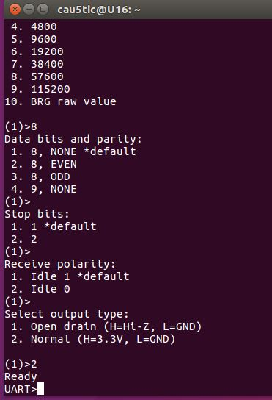
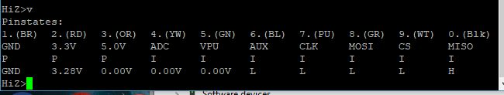
Bus Pirate Setup

Slide 18
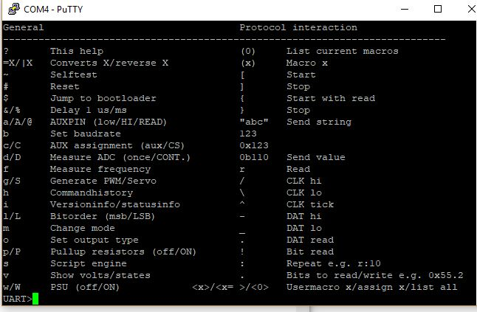
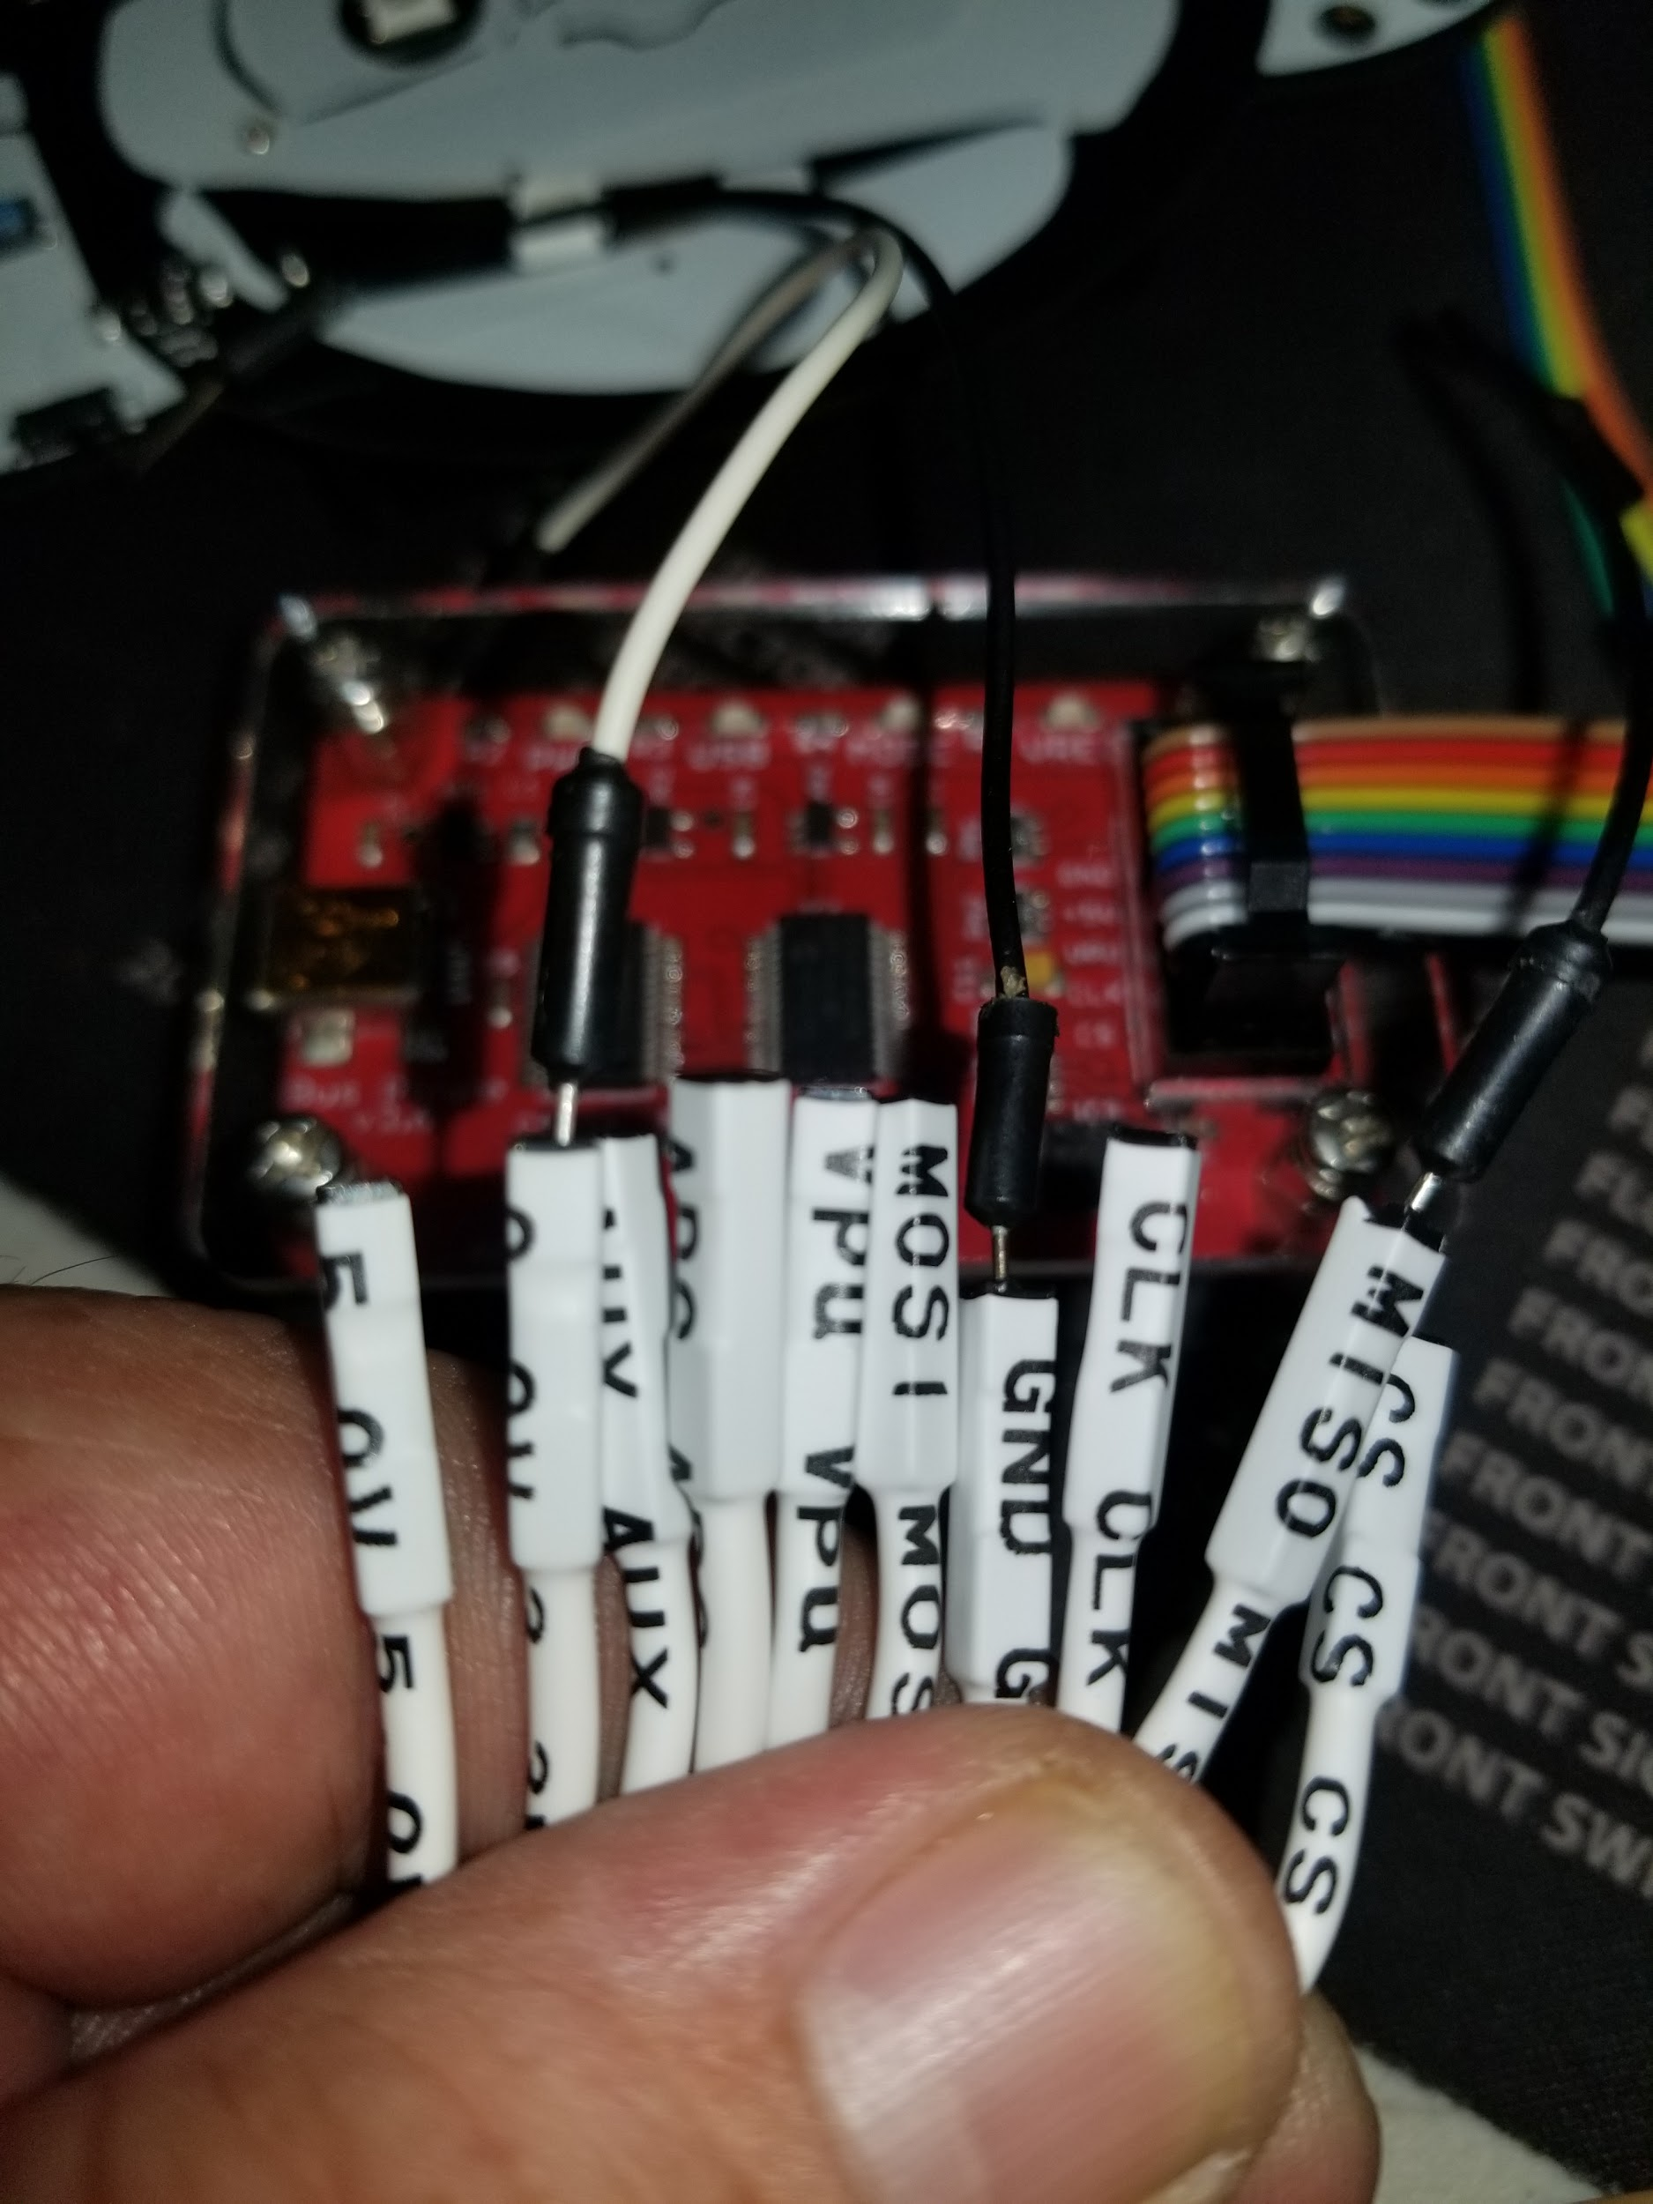
Bus Pirate Setup

Slide 19
Access Granted
For our NetGear example, reboot the device and hit enter in your terminal window when it’s powering up.
In this case, Marvell bootloader comes up and enter stops the loading process
Very typical for embedded devices running Cent or some hacked Linux distro
Stopping the boot process or in a ‘bricked state’ it won’t fully boot and you will be a UBOOT prompt.

Slide 20
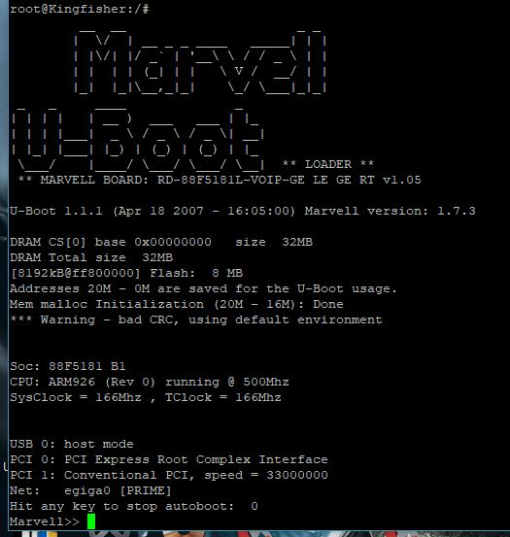
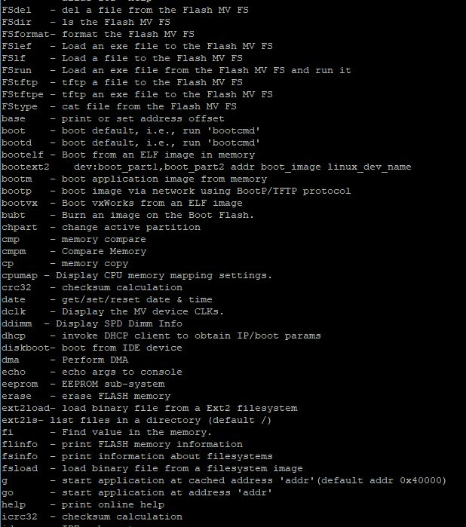
Low Level Access (pre-boot)

Slide 21
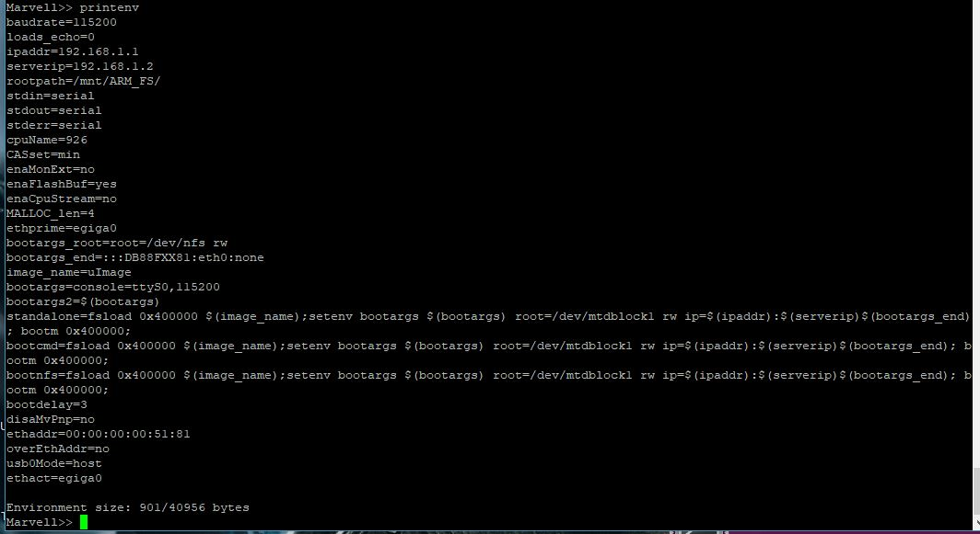
Target Device Settings
Server IP= Address it will look for a TFTP image- Why is this needed?
Other information that looks fun? All of the boot arguments point to memory address of 0x400000

Slide 22
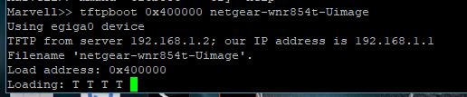
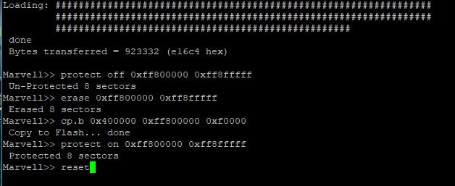
Low Level Access (pre-boot)
Quickest way to get a working firmware installed on devices that have ETH- set up TFTP/BootP server with the firmware image at the IP the device is set to, in this case 192.168.1.2
Issue tftpboot 0x400000 [firmware name on TFTP server]

Slide 23
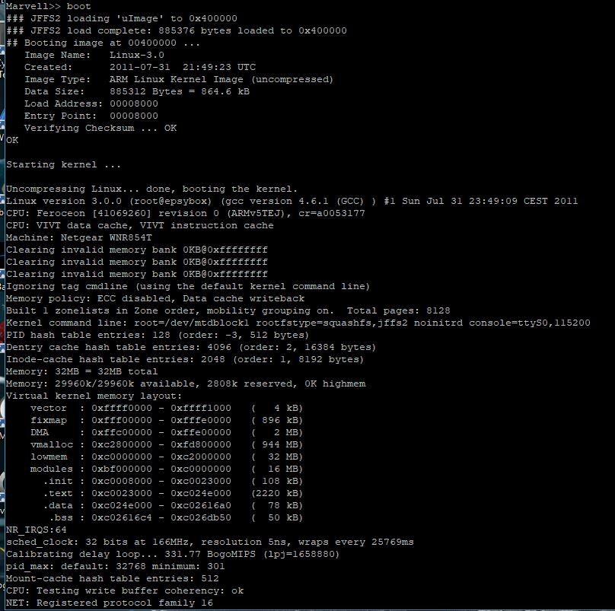
NICE

Slide 24
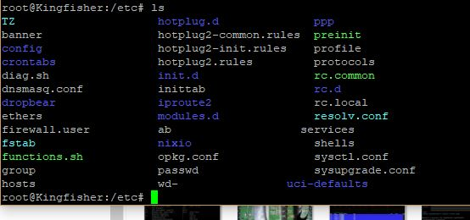
Not just for debricking
Very typical of IOT/Embedded devices, physical access usually means game over.
Once the device has booted up, hitting enter on your terminal (via serial) grants you access, usually root with no authentication.

Slide 25
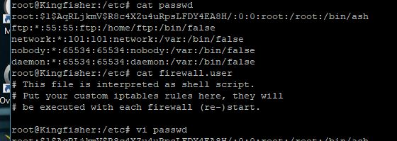
Not just for debricking
Obviously we have root so depending on the device we can pull off hashes, keys, certificate etc.
Some devices don’t use shadow passwords but it’s really a mute point now
Does that root password field give you any clues from last preso? (not that it matters here)

Slide 26
Annnd then?
Many times there are no checksum checks when flashing firmware this way. Remember we deleted the contents of of protected flash storage@ 0xFF800000? That address holds the pointer for preboot and validation data for the actual boot image to initiate. We can point this to any non protected memory address to boot (insert bad things here).
Another option is stopping the boot process (hitting enter) and running boot 0xeviladdress

Slide 27
Annnd then?
Many times there are no checksum checks when flashing firmware this way. Remember we deleted the contents of of protected flash storage@ 0xFF800000? That address holds the pointer for preboot and validation data for the actual boot image to initiate. We can point this to any non protected memory address to boot (insert bad things here).
Another option is stopping the boot process (hitting enter) and running boot 0xeviladdress

Slide 28
End Of Line
Good method for unbricking devices
No authentication typically
Injecting into the pre-boot sequence
Potential injection vector
Reverse shell from the firmware!
Does not always work, sometimes JTAG must be used
Poking around don’t short out TP’s or the device may die
Dogpile, Google or DDG searches
Bus Pirate
JTagulator
Serial Test Points
JTAG [Device Model]
Depending on how bad you bricked, this may not always work

Slide 29

Questions?
Feedback?
Future ideas - Deeper into Serial, JTAG, Mobile, Firmware exploiting?

